Slide 1
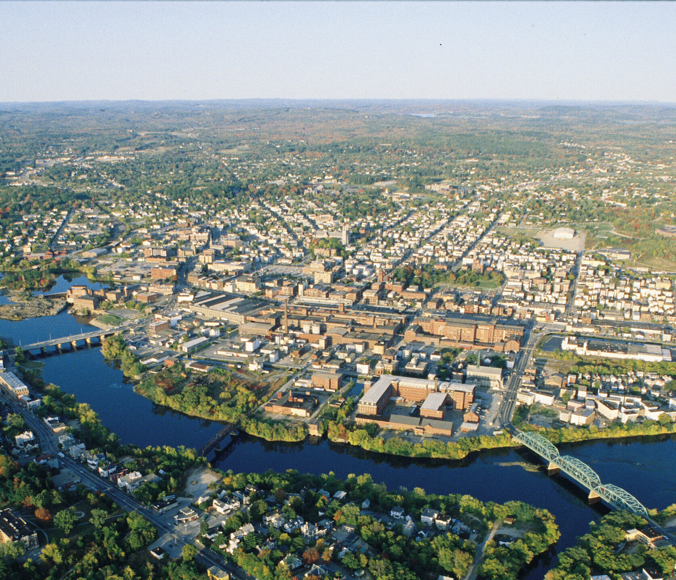

Lewiston
Tastemakers Initiative
Brunswick, ME
August 6, 2019

Slide 2
Quick Facts
2nd largest City in Maine
Employment Center
  22,000+ jobs
  1,068 establishments
Major Service Center
  2 hospitals
  6 colleges
  State/Local Government Services

Slide 3

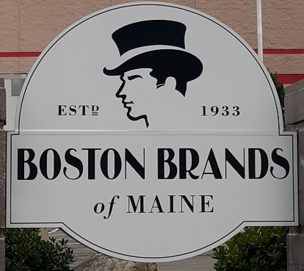






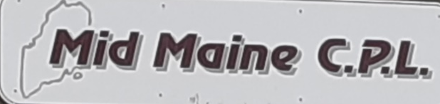

Made Here
Bob's Peanuts & Candy Inc.
Lewiston, Maine

Slide 4
Advantages
Experienced work force
Access to markets
Work force training
Abundant utility capacity
Clear and Predictable regulatory process
Council and Planning Board support economic development
TIF, Pine Tree Zones,
Robust bank and secondary financing
Real Estate Costs starting at $3.95 psf triple net

Slide 5
Exit 80
Presented to
NNECAP Conference
Brunswick, ME
October 5, 2012

Slide 6
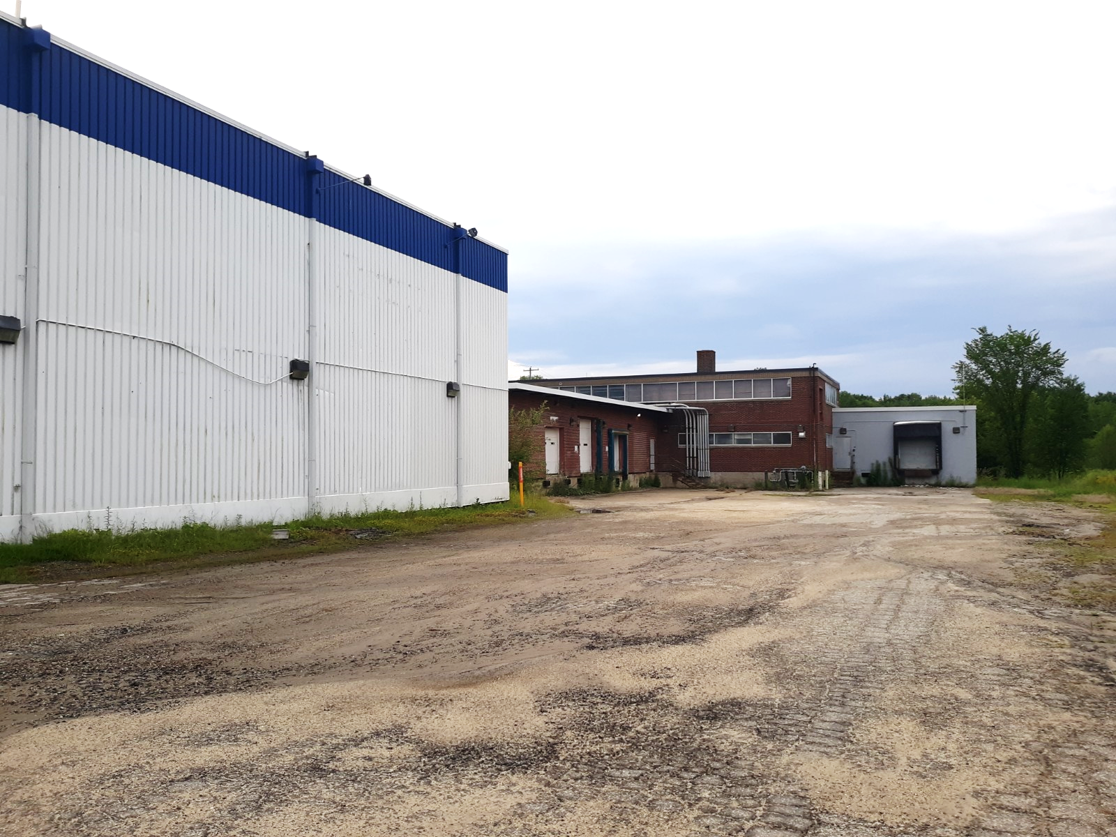
48 Commercial Street
66,000 s.f.
$3.95 psf NNN

Slide 7
71 Commercial Street
$5.50 psf NNN

Slide 8
2 – 4 Gendron Drive
$6.50 psf NNN

Slide 9
Gendron Business Park
New Construction 5,000 – 120,000 s.f.

Slide 10

Downtown

Slide 11
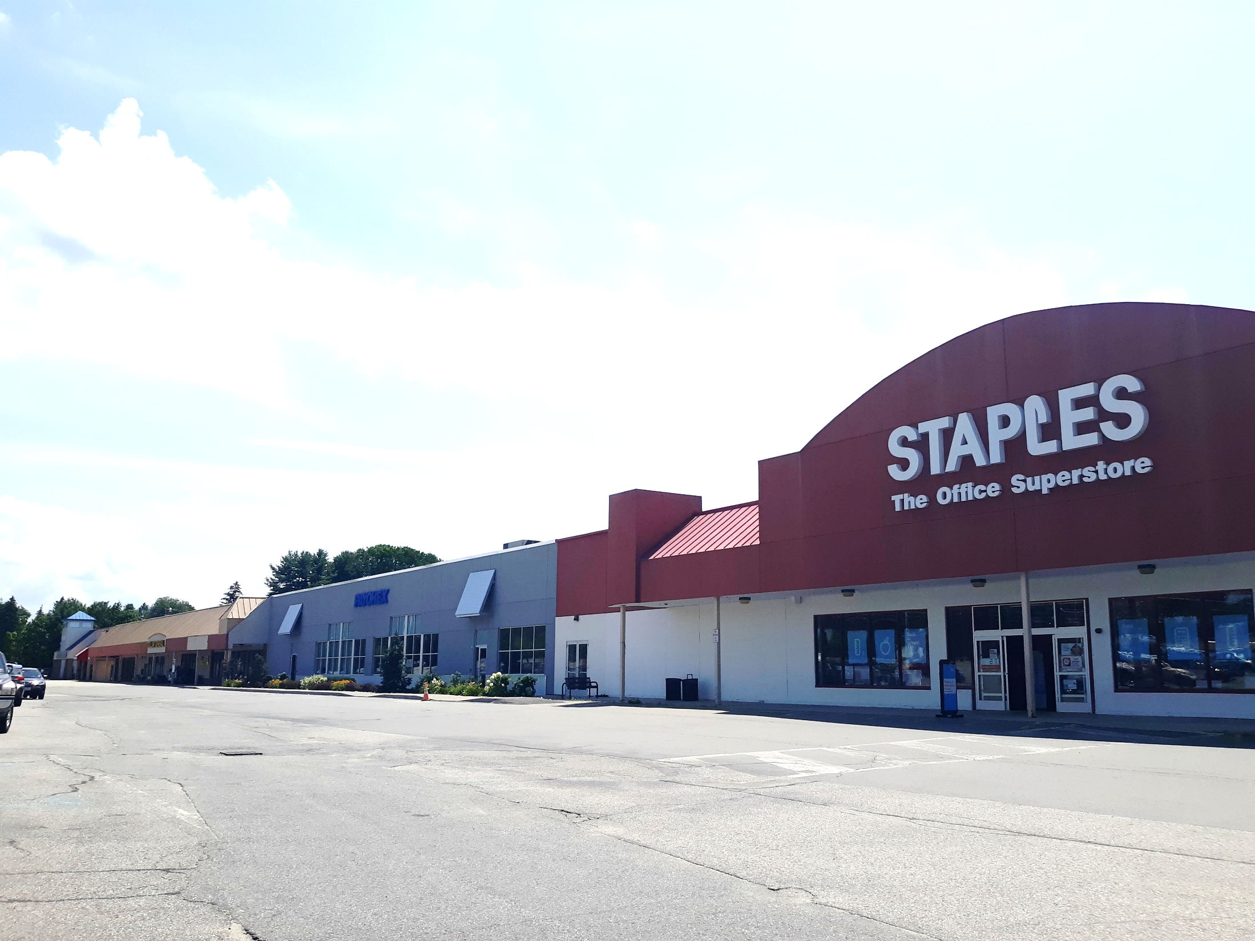
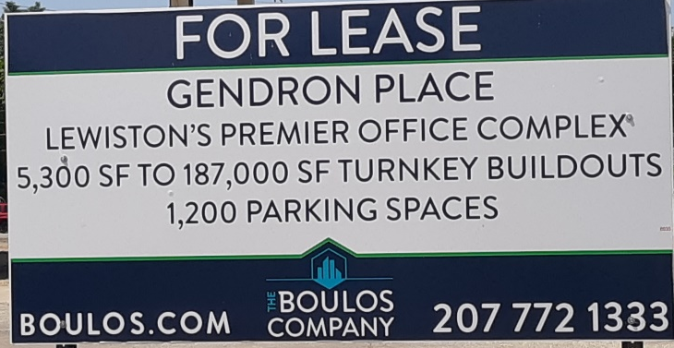

Slide 12
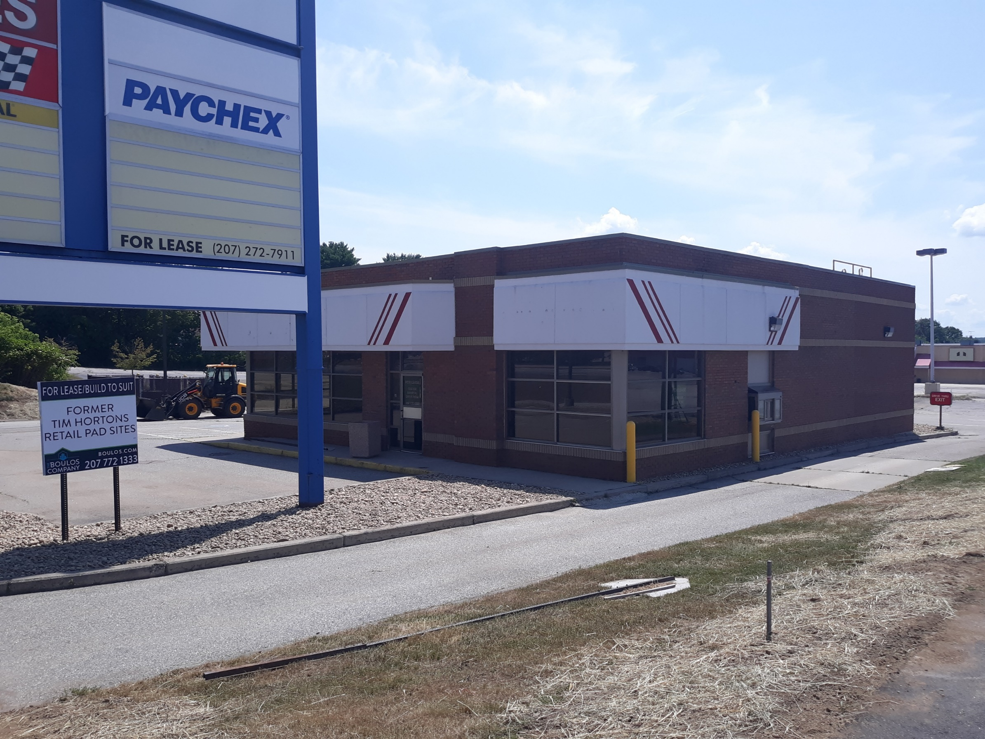
855 Lisbon Street
3,000 s.f.

Slide 13
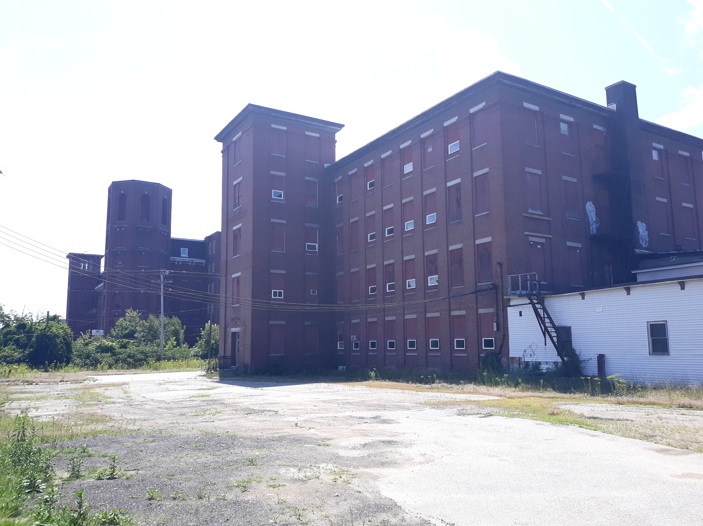
35 Beech Street
Mixed Use– 10,000 s.f. commercial

Slide 14
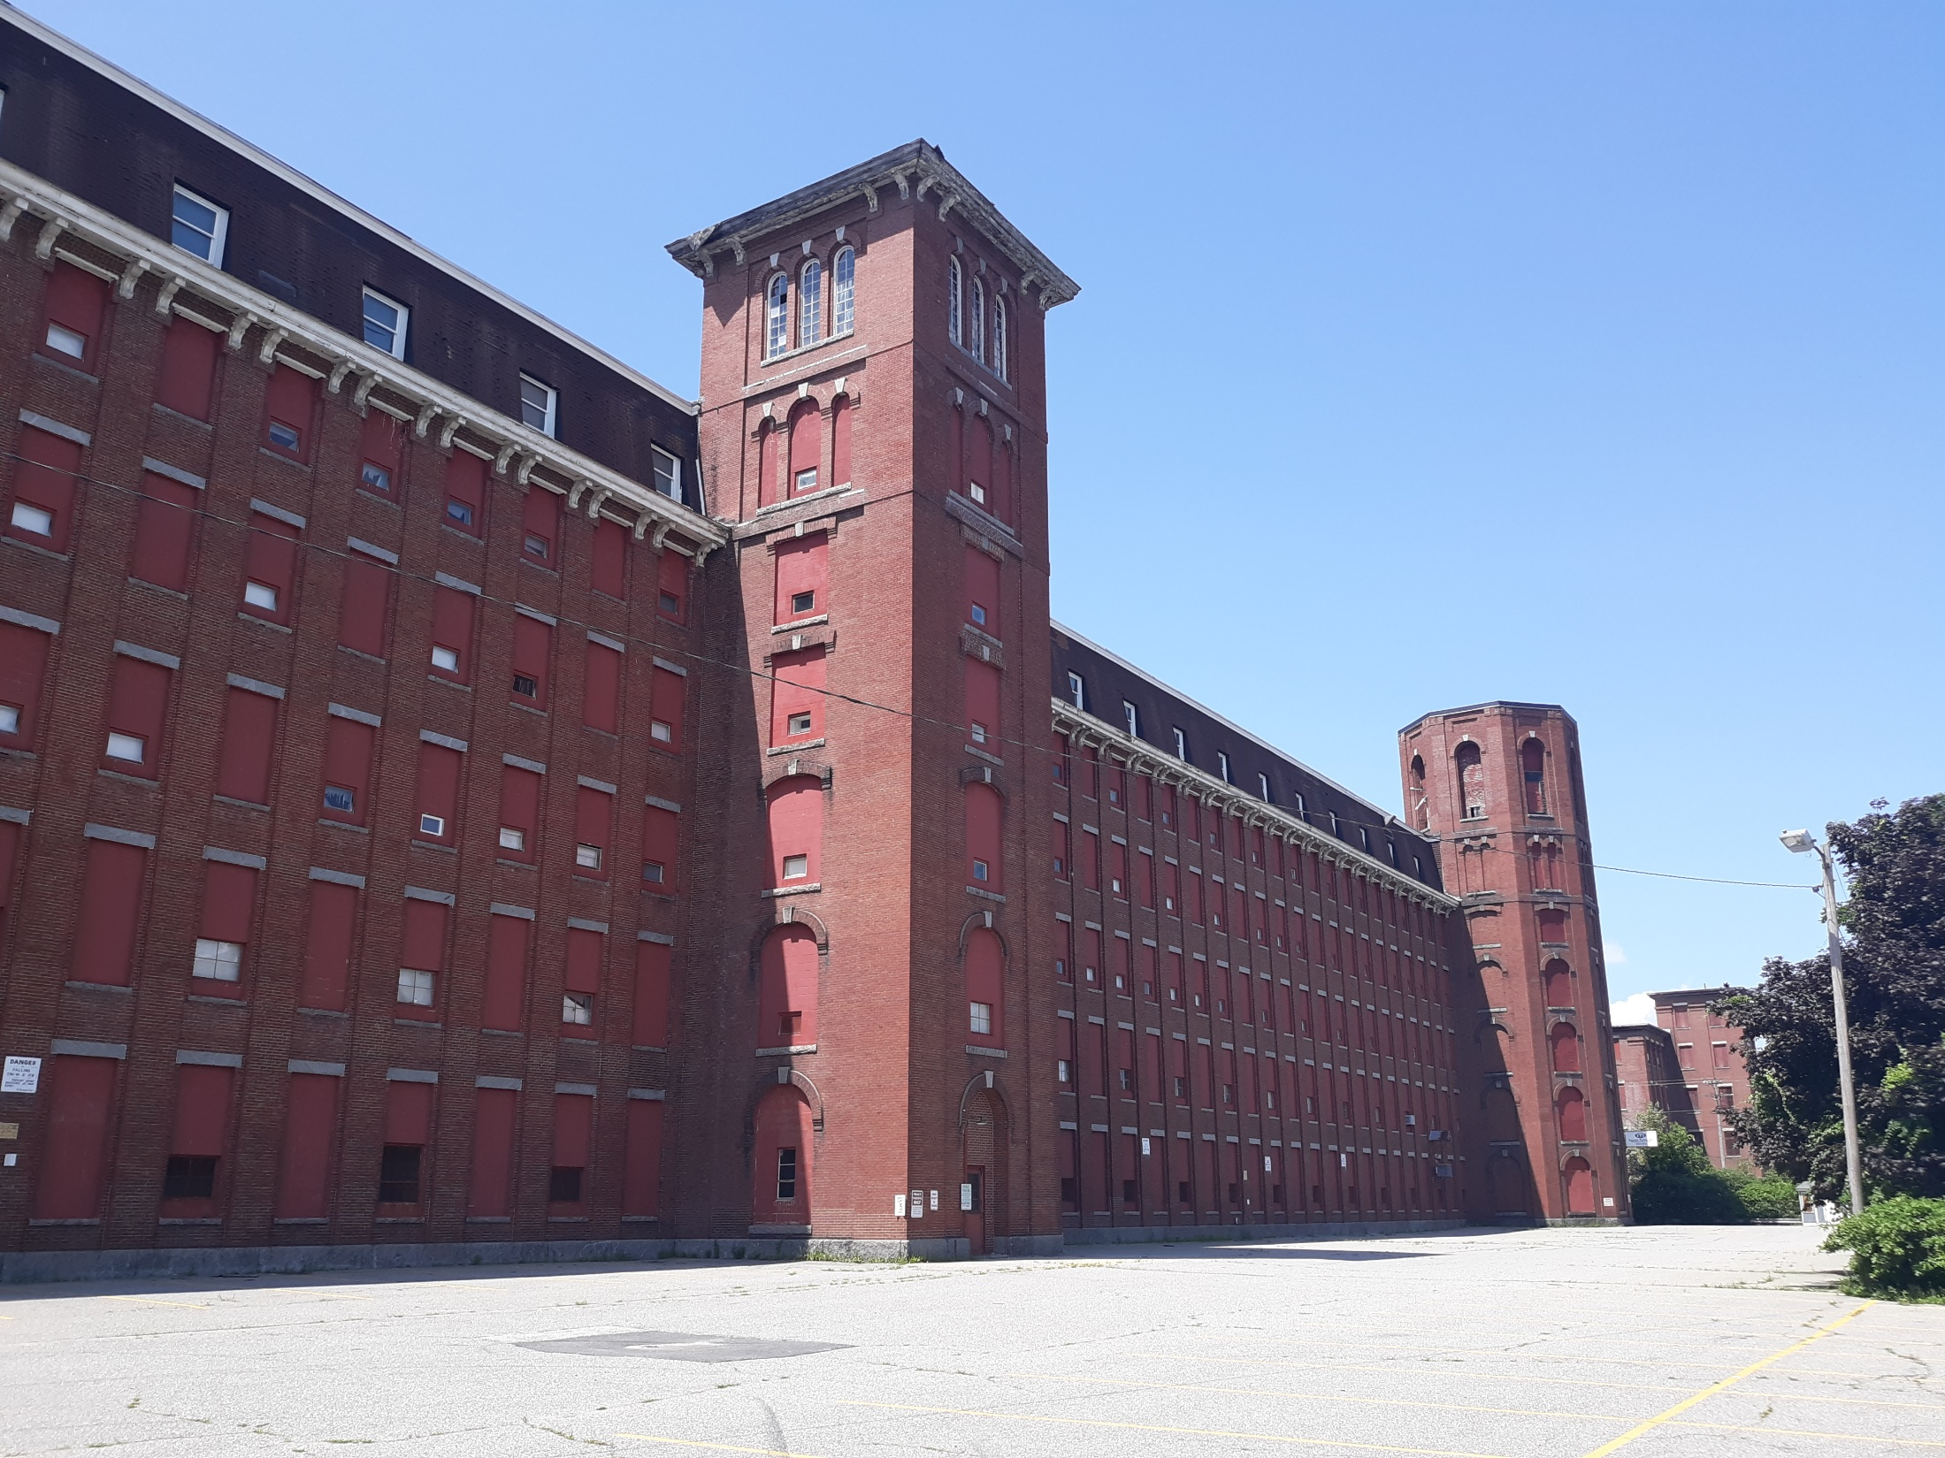
Continental Mill
560,000 s.f. on the river
New owner looking for tenants

Slide 15
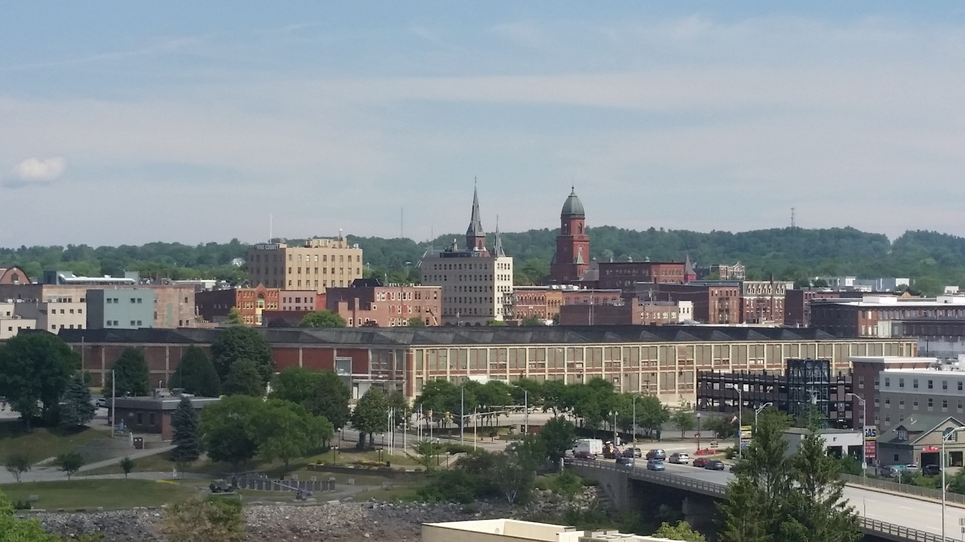
Bates Mill

Slide 16
Thank you!
For more information
Lincoln Jeffers
Director of Economic & Community Development
ljeffers@lewistonmaine.gov
(207)513-3014
Misty Parker
Economic Development Manager
mparker@lewistonmaine.gov
(207)513-3000 ext.3230

